Slide 1
ダイナミックレンジの大きな
電荷有感型前置増幅器の開発
M. Kurokawa^{a)}, H. Baba^{a)}, T. Gunji^{b)}, H. Hamagaki^{b)},
S. Hayashi^{b)},T. Motobayashi^{a)}, H. Murakami^{a)}, A. Taketani^{a)},
M. Tanaka^{c)}, Y. Togano^{a)}, K. Yoneda^{a)}
a) RIKEN, Nishina Center
b) CNS, the Univ. of Tokyo
c) KEK

Slide 2
大きなダイナミックレンジが必要となる原子核実験
（中間エネルギー領域）
Coulomb breakup exp.（陽子捕獲反応の逆反応）
proton
Definition of dynamic range
upper limit / lower limit (= 4σ)
of detection
heavy particle
(z < 50)
proton rich particle up to ¹⁰⁰₅₀Sn
Dynamic range of the electronics ~ 10^4
  coincident measurement from proton (z = 1)
  to heavy ions (z ~ 50) → 2500
  Pileup of beam events
Nuclear decay spectroscopy
Implantation > GeV
β decay > a few tens of keV

Slide 3
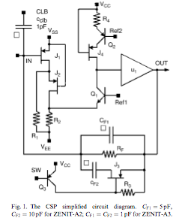
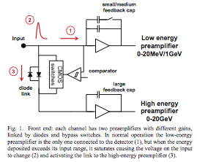
これまでに開発が行われた回路の例
I.
II.
このレベルに応じて
瞬時に切り替える
Ref.) D. Braga, et al., IEEE NSS-MIC 2009
Conf. Rec., 1924 – 1928.
III. TOT
Ref.) M.A. Baturisky, et al., Nucl. Instr.and Meth.
A 496 (2003) 162 – 171.
Ref.) V. Bonvicini, et al., Nucl. Instr.and Meth.
A 572 (2007) 340 – 344. → 10000 MIP 実現
S/N = 5 for 1 MIP

Slide 4
Architectures of the present ASIC
Cf = 1.8 pF
Rf = 50 MΩ equivalent: Krummenacher feed back circuit is used
ref.) F. Krummenacher, Nucl. Instru. Meth., A305 (1991) 527.
Power consumption 10 mW/ch
Capacitive division
Openloop gain
Saturation suppression

Slide 5
Architecture I: dual channel system
Input charge is divided in proportion to the capacitance ratio between coupling capacitances Ch and Cl (Ch > Cl).
Ref. ) N. Uematsu and S. Nishimura, “Development of silicon strip detector with wide-dynamic-range readout system from
20 keV to 4 GeV”, RIKEN Accel. Prog. Rep. 41, (2008) 151.
Qh = Qin × Ch / (Ch + Cl)
Log Vout
Extended as much as the
capacitance ratio
high-gain
channel
CSA
Qin
Ch
similar response with
single channel system
Cl
low-gain
channel
CSA
H
Ql = Qin × Cl / (Ch + Cl)
L
Log Qin
4 pC
40 pC
Ch = 10 × Cl

Slide 6
Architecture II: cascode current mirror for the achievement of ideal A
Equivalent circuit for the dual channel system
ZCh
Zin
At rising edge of the pulse, Zin = 1 / (A Cf s)
A: open loop gain
To divide the input charge in proportion to the capacitance ratio, input impedance of the CSA has to be negligible small. → A = ∞ is ideal
→ ideal current source
Cascode current mirror is employed.
It has the similar structure with HINP16C to
reduce the voltage drop.
ZCl
Zin
Cacode current mirror
w/l--> small
w/l--> large
w/l--> small
LogA
80 dB
w/l--> large
w/l--> large
50 dB
input
LogHz
w/l--> small

Slide 7
Architecture III: saturation suppression
If Qin is large enough to saturate the high-gain channel,,,,,,,
Log Vout
Z of the CSA for the high-gain channel is quite large!
Charge flows into low-gain channel.
Capacitive division does not work there.
H
L
Log Qin
Saturation suppression for the high-gain channel is implemented.
Vg
This FET is turned ON when Vth > Vg - Vout
Charge flows into this FET,
becauce of its small drain-source resistance.
Vout
CSA

Slide 8
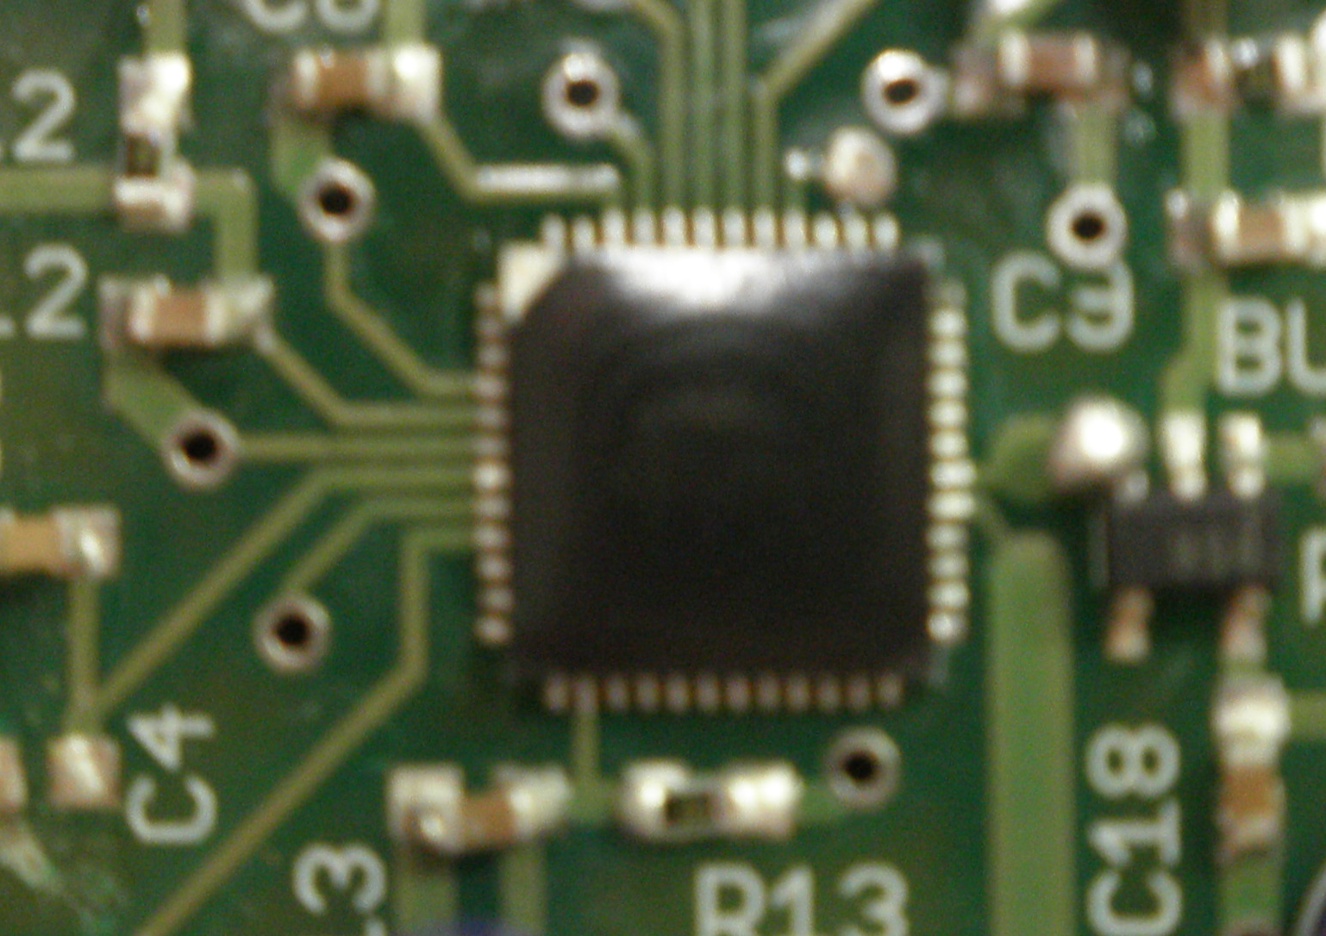
Output pulse shapes from the CSAs
CSA
H
This part is implemented in first prototype
Ch
Cl
Chip and its test board
TSMC 0.5 μm process
chip size ~ 1.6 mm × 1.2 mm
L
CSA

Slide 9
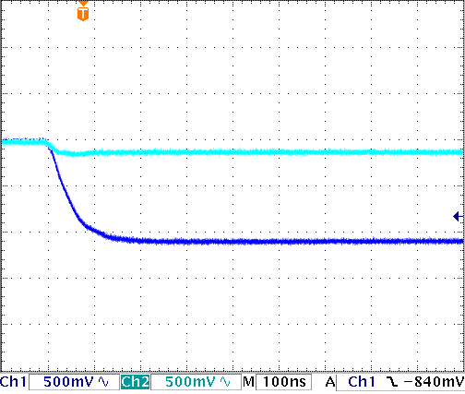
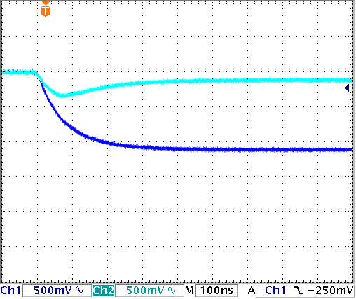
Output pulse shapes from the CSAs -- I
Qin = 3.2 pF (FET is Off)
Ch = 560 pF
Cl = 56 pF
Ch = 4.7 nF
Cl = 470 pF
I
L
L
1
H
1 /( Cl s)
H
10
1 /( Ch s)
R
(=Zin)
100 nsec/div
100 nsec/div
Impedance of each ch.
Rise time is a function of Cin, Ch, Cl and Zin and depends on √(Cin² (1 / Ch – 1 / Cl)² + 4)
Usually is a funcionf Cin & Zin

Slide 10
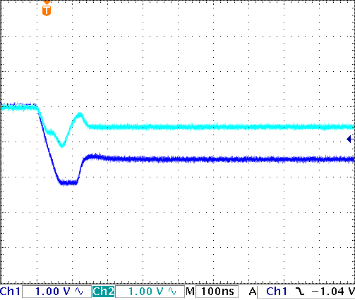
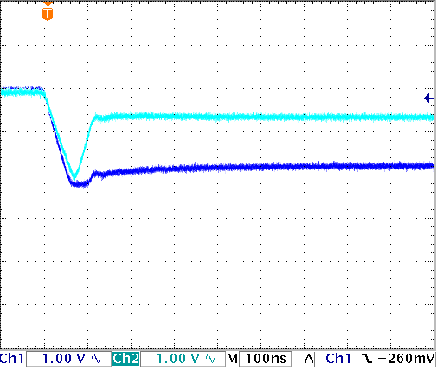
Output pulse shapes from the CSAs -- II
Qin = 16 pF (FET is On)
Ch = 560 pF
Cl = 56 pF
Zin → source-drain resistance of the FET
Ch = 4.7 nF
Cl = 470 pF
off / on/ off
Saturation suppression is working.
Shape shows plateau,
but not due to the saturation.
Anyway, the effect of the bumps will be filtered by subsequent analysis
with τ ~ 1 μs.

Slide 11
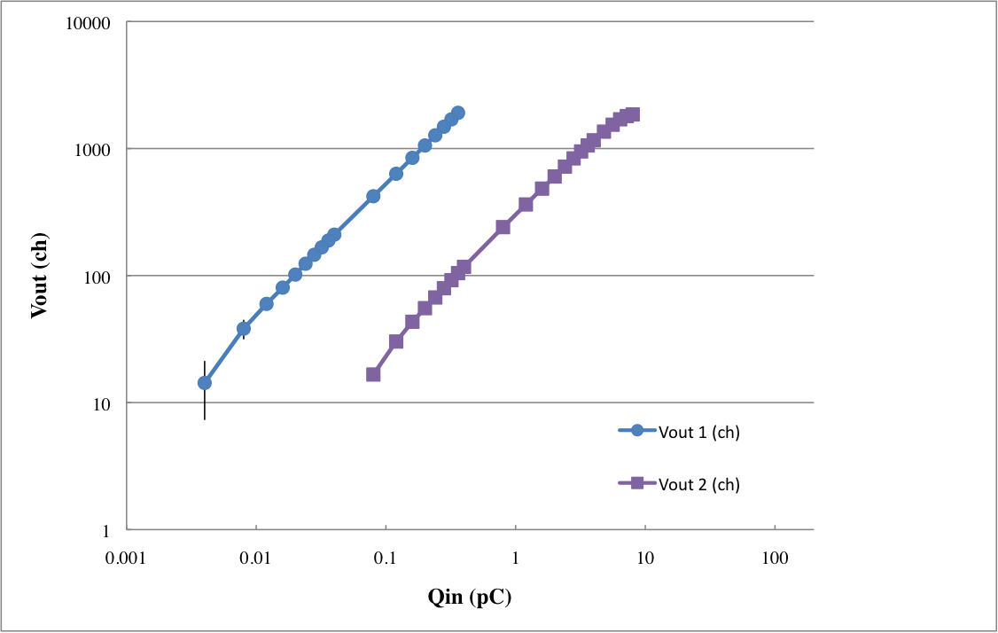
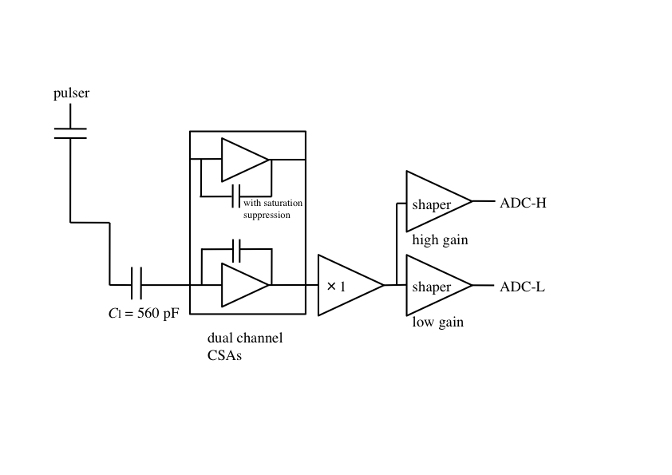
Result I: Dynamic range for a single channel CSA
10⁴
10³
10²
10¹
ADC-H
5.2 fc
5.6 pc
ADC-L
10⁰
10⁻³
10⁻²
10⁻¹
10⁰
10¹
10²
Definition of lower limit = 4σ. 4.4 fC corresponds to 100 keV.
Dynamic range ~ 10^3

Slide 12
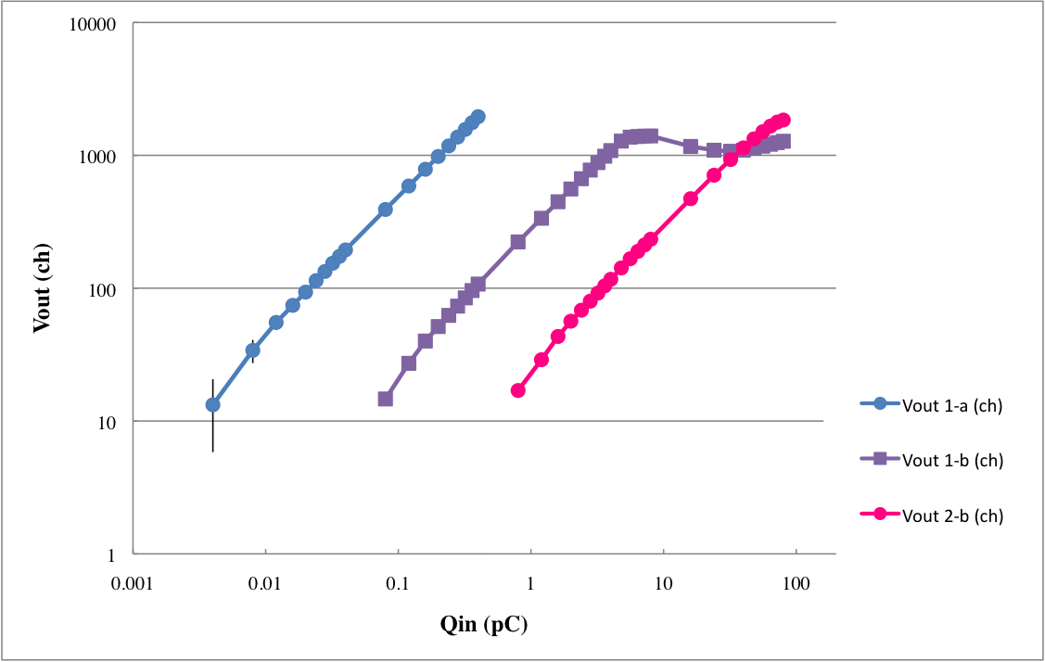
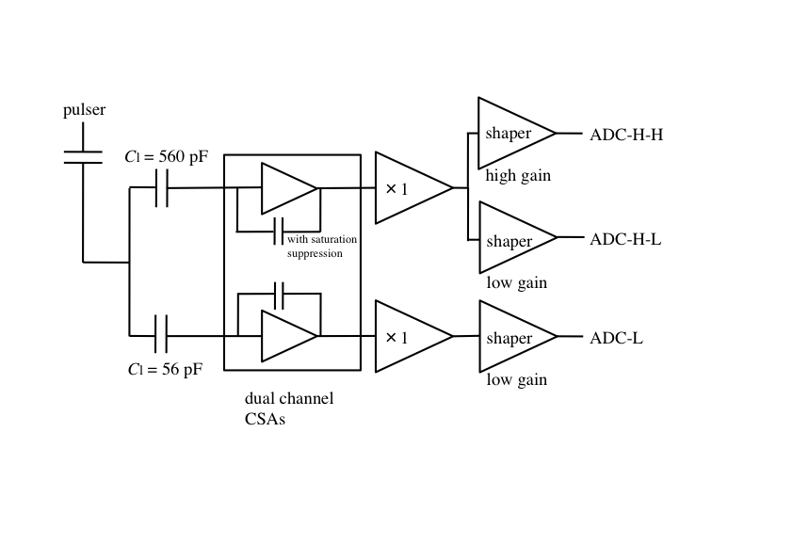
Result II: Dynamic range for dual channel CSAs
Dynamic range ~ 10^4
10 times wider than that is obtained
for the single channel usage
10⁴
10³
10²
ADC-H-H
10¹
ADC-H-L
5.8 fc
56 pc
ADC-L
10⁰
10⁻³
10⁻²
10⁻¹
10⁰
10¹
10²
Definition of lower limit = 4σ

Slide 13
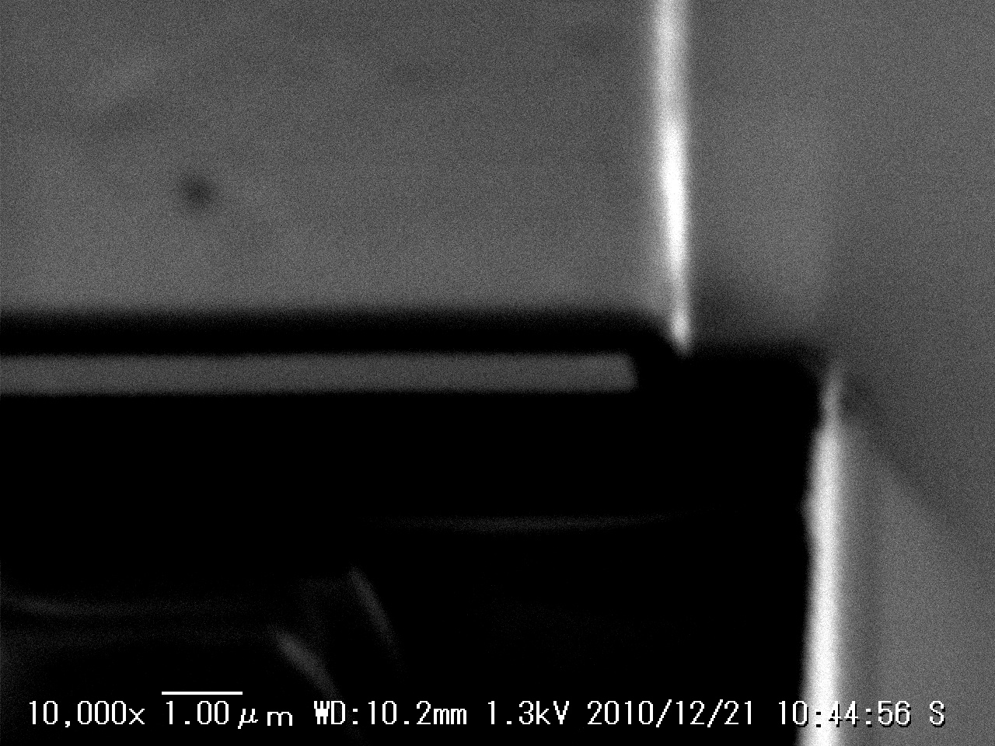
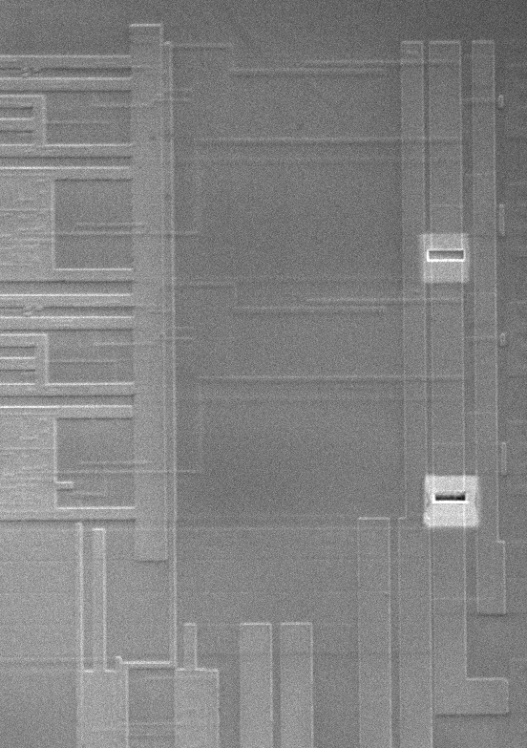
Example of the modification using FIB@RIKEN
Insulation layer
Disconnection of traces
passivating coating
Metal (Al) layer
Limited area was irradiated with
Ga beam
RIKENDGCSP
enlarged and tilted view

Slide 14
Summary
First prototype of RIKENDGCSP (Riken Dual Gain Charge Sensitive Preamplifier) is working well. Dynamic range can be extended as much as the gain ratio.
Second prototype is now under fabrication
電流量：
エミッターフォロアー
の電流量で決まる
CSA
CSA

